Slide 1

ENTERPRISE SOFTWARE DEVELOPMENT
Notes:
if possible, SQL Server Management Studio should be 25% bigger
the book index is pretty small text, maybe just do one page or even part of a page to illustrate your point
QUESTION: Should you use create indexes for foreign keys if you frequently search by them, use join on them or order by?

Slide 2
SSW Template
Version 4.0 by SSW Design Tip: Slides have additional info in View | Notes.
Notes:
V4.0 Beautified by Jayden

Slide 3

User Group Presenter’s Alternative Title Slide
Delete these boxes, then replace this promo image with yours

Slide 4

Database Performance for Developers Do you have a plan?
.NET User Group March 2023

Slide 5
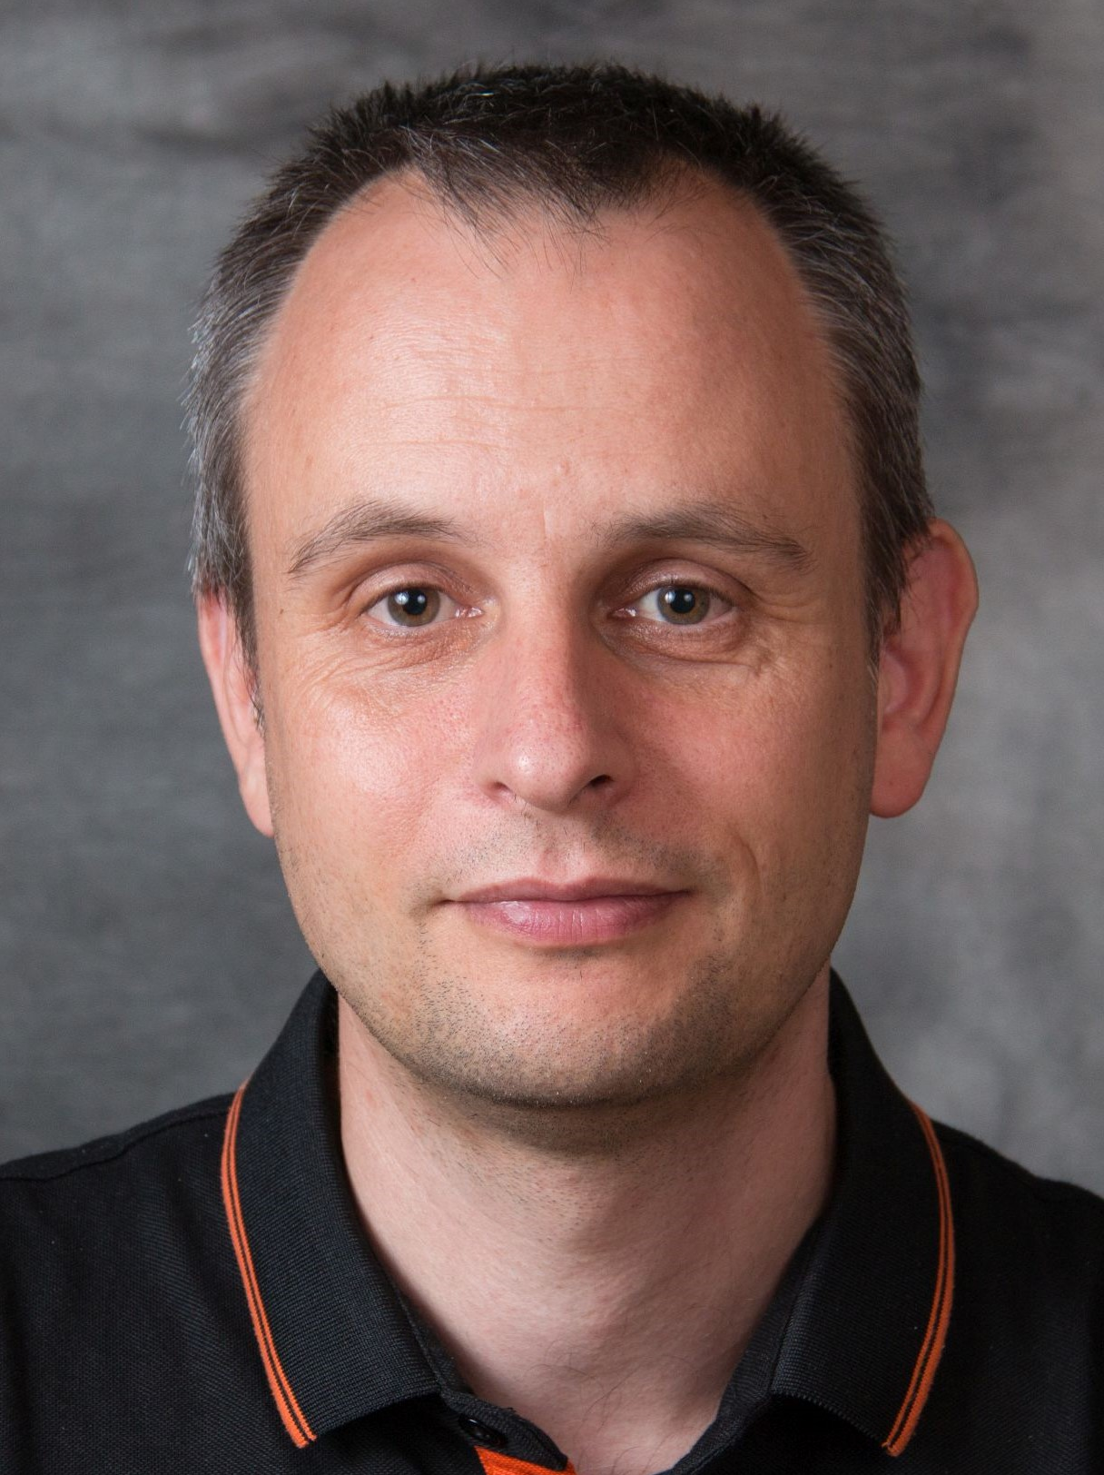


Bryden Oliver
SSW Solution Architect
http://www.linkedin.com/in/brydenoliver
https://github.com/brydeno
20 years experience in database performance
Worked with Azure since its launch
Is 2 inches shorter than he used to be
Knows all about Azure at scale
Ask me about Cosmos DB

Slide 6
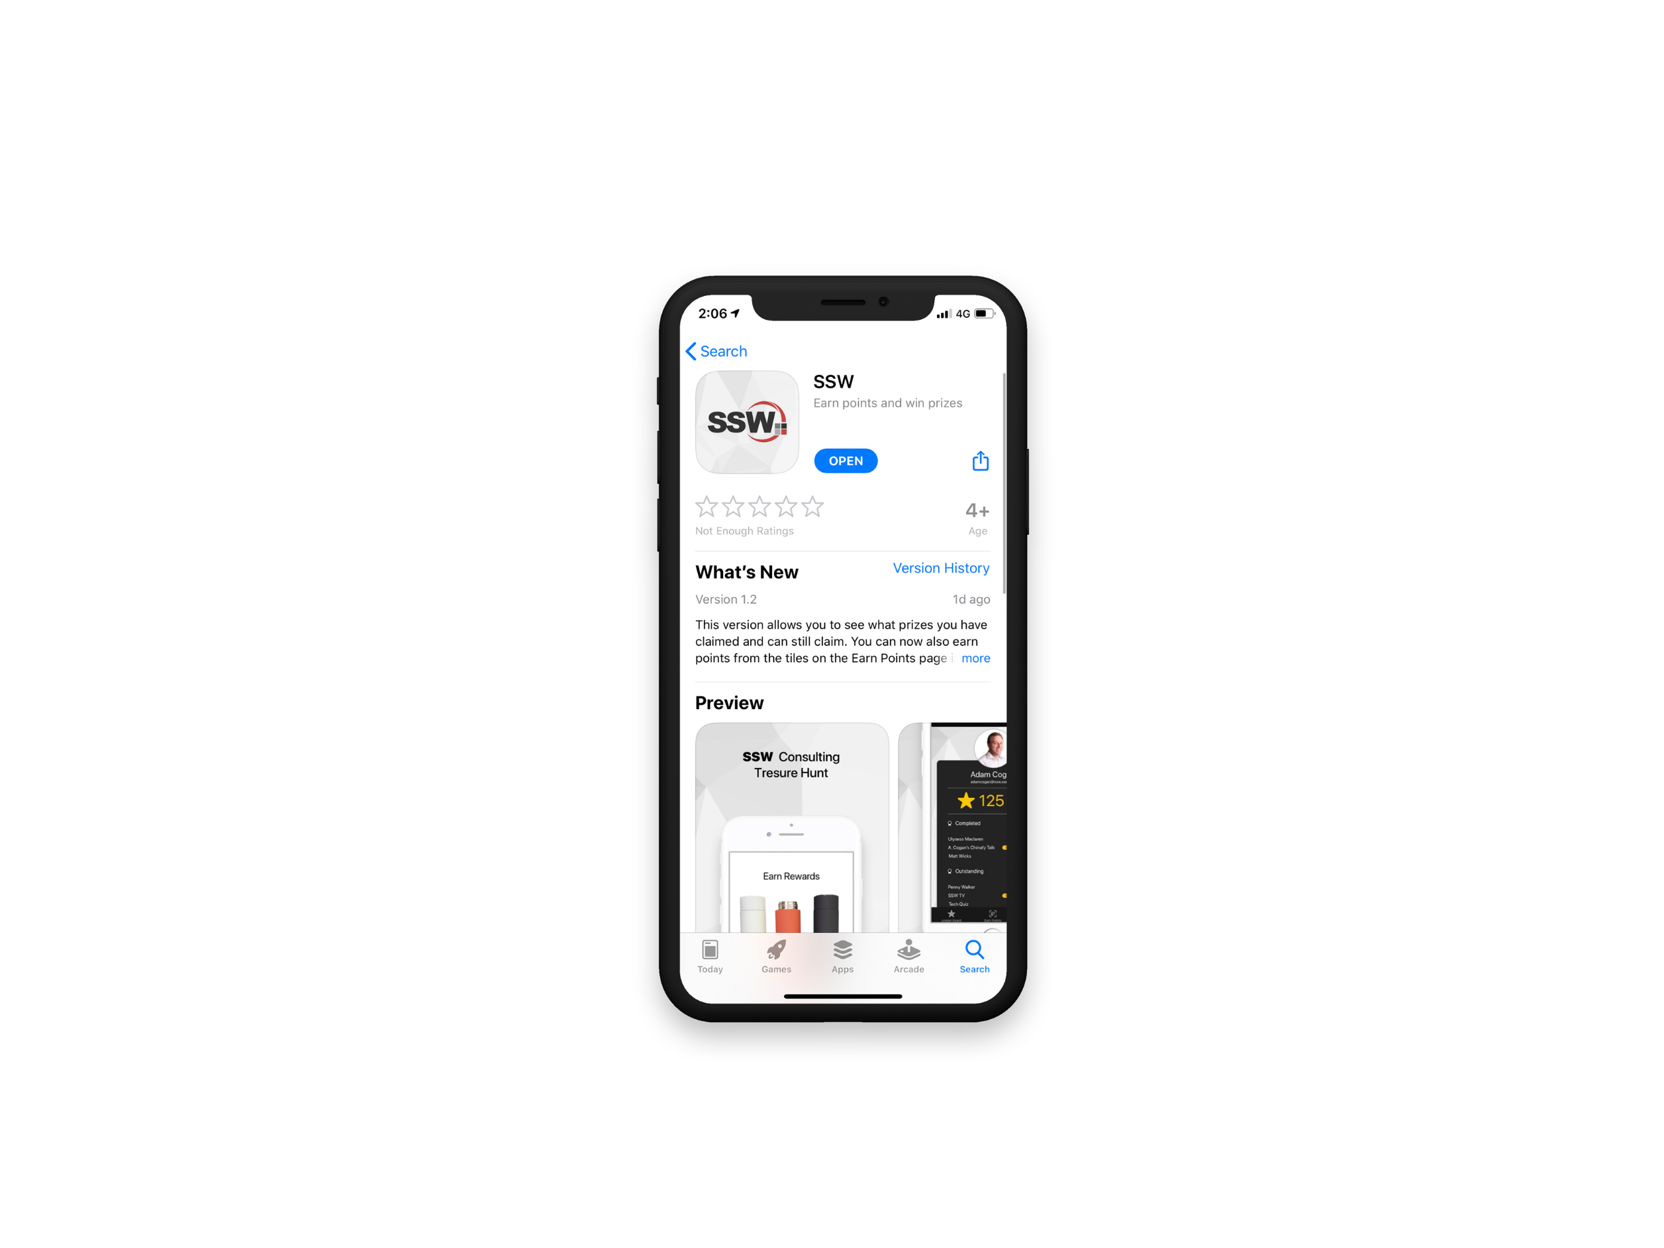

Scan QR Code to install app
Scan SSW codes at talks and events
Earn SSW Points
claim rewards, and win prizes
SSW Rewards
Notes:
An SSW Admin will give you your QR code https://my.sugarlearning.com/SSW/items/13946/ssw-rewards-setup-the-ssw-rewards-app

Slide 7


Agenda
1. Intro
2. SQL Server Query Execution
3. Execution Plans
4. Simple Monitoring
5. Selecting appropriate indexes
6. Summary

Slide 8

Intro
We write code, and it ends up calling SQL Server
What happens after that?
Can we understand that?
How can we improve what happens?

Slide 9

We’ll cover lots of ground
Whole presentation is in github
Demos are too
https://github.com/brydeno/DatabasePerformance

Slide 10

Why talk about indexes?
Easiest way to reduce both IO and CPU pressure
Relatively easy to understand
We’ll see all this in the demoes later

Slide 11
Agenda
1. Intro
2. SQL Server Query Execution
3. Execution Plans
4. Simple Monitoring
5. Selecting appropriate indexes
6. Summary

Slide 12
What happens when a query executes?
SQL Engine
Compilation
Optimization
Storage Engine
Execution
Execution

Slide 13
Is there more to it than that?
What the SQL Engine sends to the Storage Engine is called a Query Execution Plan
These are cachable
Kept in the Plan Cache

Slide 14
What happens when a query executes? (2)
SQL Engine
Plan Cache
Not found
Compilation
Optimization
Storage Engine
Query found in cache
Execution
Execution

Slide 15
Agenda
1. Intro
2. SQL Server Query Execution
3. Execution Plans
4. Simple Monitoring
5. Selecting appropriate indexes
6. Summary

Slide 16
Why do we care?
Because we can see the plan
Plans tell you lots of stuff
Let’s dive in

Slide 17
DEMO stuff
How to include plans when executing SQL
Viewing plans
SSMS Plan Viewer
Raw (XML)
Spotlight Tuning Pack (only upon execution), SSMS 18 or less
Choose the ones you like most, all are free
I’ll use SSMS Plan Viewer for the rest of this session

Slide 18
What stats are available?
Execution Count
Duration (ms)
CPU Time (ms)
Logical Reads (KB)
Logical Writes (KB)
Physical Reads (KB)
CLR Time (ms)
DOP (Degree of parallelism)
Memory Consumption (KB)
Row Count
Log Memory Used Kb
Temp DB Memory Used Kb

Slide 19
Agenda
1. Intro
2. SQL Server Query Execution
3. Execution Plans
4. Simple Monitoring
5. Selecting appropriate indexes
6. Summary

Slide 20
Which ones are important?
Well it depends ☺
What resources are constraining SQL Server?
How can we find that out?
What can we do about it in our queries?

Slide 21
DEMO
Getting I/O and CPU numbers
SSMS - Reports – Performance Dashboard– Historical Waits
Now we know what pressure SQL Server is under

Slide 22
DEMO - How to get plans?
Include Execution Plan
Query Store in SSMS

Slide 23
Other useful tricks
It’s always useful when running locally to get query statistics
Run SET STATISTICS IO ON;
Before you run your query
We’ll see this in the demos ☺

Slide 24
Further techniques
DMVs
Profiler
Query Store
Extended Events
Wait Stats
Locking/Blocking
Deadlocks
Look out for my Advanced SQL Server Performance session to learn more

Slide 25
Agenda
1. Intro
2. SQL Server Query Execution
3. Execution Plans
4. Simple Monitoring
5. Selecting appropriate indexes
6. Summary

Slide 26
Picking good indexes
Relating to the real world
Indexing where clauses
How to test index changes
Indexing Order by
Indexing Joins

Slide 27
Relating to the real world
The best analogy I find is a book index
Try and execute some “queries” using your book index.

Slide 28
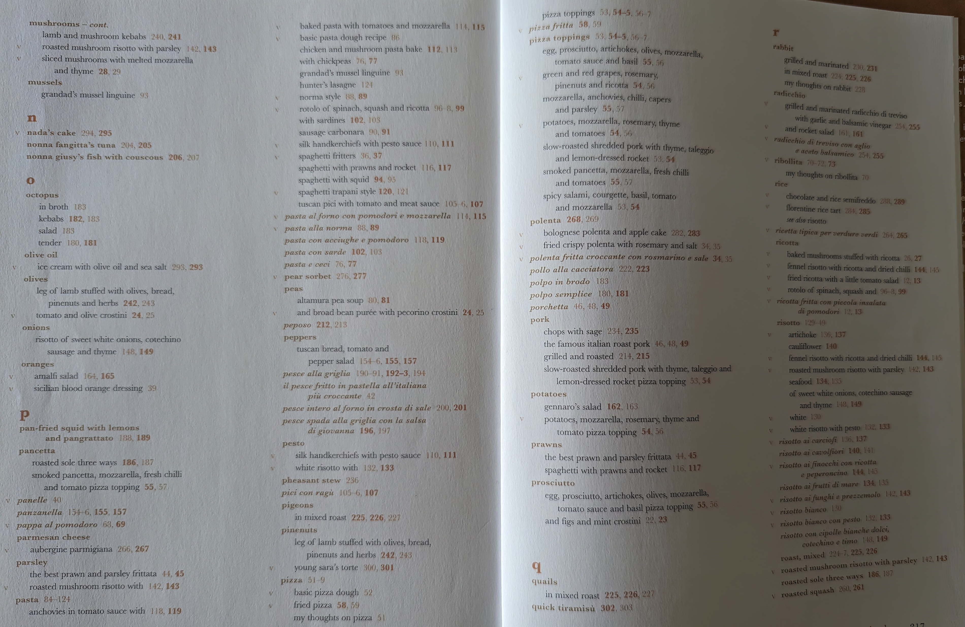

Slide 29
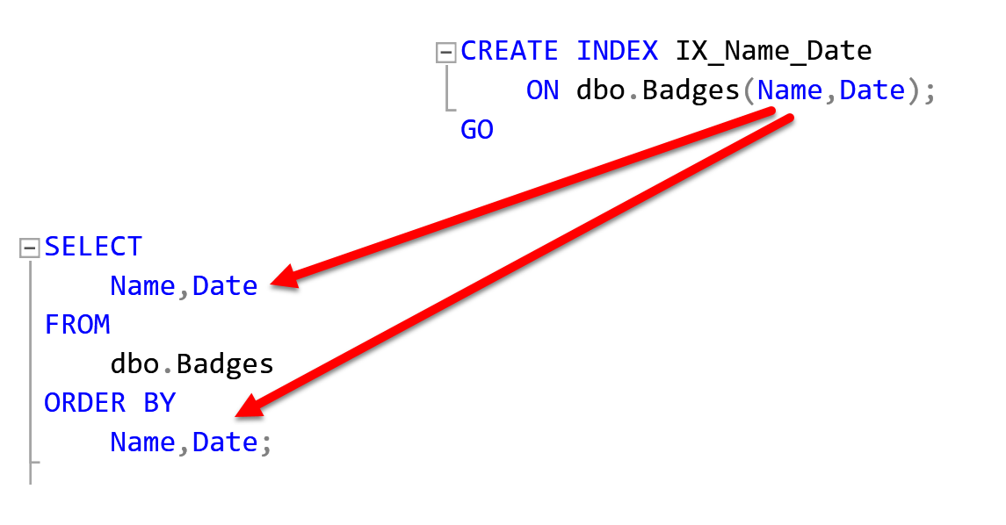
Wait before creating your index
You can clearly visualize your index
Write a SELECT

Slide 30
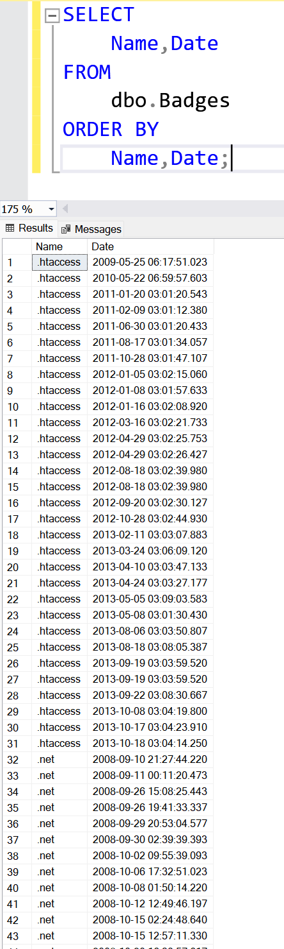
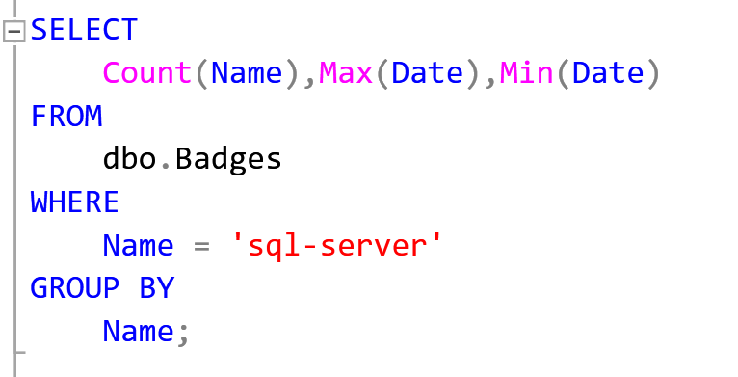
Will this help for the query we want
Try answering by hand
We want the number of people with a particular badge and the first and last date someone obtained them
So:……
As a SQL Statement we get:

Slide 31
Indexing ORDER BY
This is the simplest case
Just drop the order by in the index definition

Slide 32
Let’s see that in action
SELECT DisplayName FROM dbo.Users ORDER BY DisplayName
CREATE INDEX IX_DisplayName ON dbo.Users (DisplayName)

Slide 33
How to test Indexes
Select Id,DisplayName
From dbo.users WITH (INDEX = 1) // Use the primary key
From dbo.users WITH (INDEX = IX_INDEX) // Use particular index

Slide 34
Indexing WHERE
DEMO 02 – Single Comparison
DEMO 03 – Multiple Comparison
DEMO 04 – Inequality Comparison

Slide 35
What is selectivity?
Selectivity is the proportion of rows that match a given predicate.
Calculated as number of rows with that value divided by the total number of rows
We want selectivity to be as low as possible.
A related term is cardinality

Slide 36
Now we understand that, back to THE DEMO

Slide 37
Combining ORDER BY and WHERE
Typically ORDER BY goes last

Slide 38
How to handle JOINs
DEMO 05 - Joins

Slide 39
Agenda
1. Intro
2. SQL Server Query Execution
3. Execution Plans
4. Simple Monitoring
5. Selecting appropriate indexes
6. Summary

Slide 40
Visualise indexes
Remember you can see what your index looks like with a simple SELECT
Use that to identify why your index didn’t do what you wanted

Slide 41
Test and eliminate
Create all the options
See which one SQL Server chooses
Test them by forcing SQL Server to use each choice
Select * from user with (index = blah)
Select * from user with (index = blah2)
Look at the logical reads and other perf stats ☺
SET STATISTICS IO ON; -- is your friend
DROP any indexes that don’t make the cut

Slide 42
Selectivity isn’t just uniqueness.
It’s about what % of an object is matched by:
Your WHERE clause
Your JOIN relationships
The ORDER BY, especially with a TOP
Isolate portions of your query and run separately to see how many rows will match.

Slide 43
The bigger picture
Pick indexes that cover more of the queries that run
Don’t go too specific except for the mega resource hogs.

Slide 44

Resources
Brent Ozar
brentozar.com
Pinal Dave:
https://blog.sqlauthority.com/
PASS:
passdatacommunitysummit.com/sessions/video-library/
SQL Skills:
SQL Skills
And loads more, Stack Overflow is also great
The demo database used here (and that lots of SQL demos and courses use) is sourced from: archive.org/details/stackexchange
Brent Ozar keeps a ready to deploy SQL Server database of that, easily downloadable in various sizes for people to learn with. Thanks Brent!!!
Notes:
Tip: Resources indicates that you’re nearing the end of your presentation

Slide 45
Specific further reading
Think like the SQL Server Engine
www.brentozar.com/training/think-like-sql-server-engine/
Sargable Expressions
www.sqlshack.com/how-to-use-sargable-expressions-in-t-sql-queries-performance-advantages-and-examples/

Slide 46




Scan the QR code below and earn
SSW Points for watching this talk!

Slide 47

Got feedback?
Scan the QR code here
to fill our survey.
How to Use this PowerPoint with Adam Cogan

Slide 48

Thank you! info@ssw.com.au www.ssw.com.au Sydney | Melbourne | Brisbane | Newcastle
github.com/brydeno/DatabasePerformance
Notes:
Note: You should say “thank you” and then pause for 4-5 seconds… to give the audience time to applaud!
https://www.ssw.com.au/rules/do-you-finish-your-presentation-with-a-thank-you-slide

Slide 49
Questions? info@ssw.com.au www.ssw.com.au Sydney | Melbourne | Brisbane | Newcastle
github.com/brydeno/DatabasePerformance
Notes:
Note: You should pause for applause here!
https://www.ssw.com.au/rules/do-you-finish-your-presentation-with-a-thank-you-slide

